Slide 1
FIRE AND LIFE SAFETY AUDIT
IT AND PHYSICAL SECURITY
School Of Computer Science
University of Petroleum And Energy Studies
Dehradun-248007
AUG-DEC 2023
BY: Saryu Bansal
Shreyanshi Dobhal
Akshat Negi
TO: Gopal Rawat Sir

Slide 2
WHAT IS NBC?
THE NATIONAL BUILDING CODE OF INDIA (NBC), A COMPREHENSIVE BUILDING CODE, IS A NATIONAL INSTRUMENT PROVIDING GUIDELINES FOR REGULATING THE BUILDING CONSTRUCTION ACTIVITIES ACROSS THE COUNTRY. IT SERVES AS A
MODEL CODE CONSTRUCTION GOVERNMENT CONSTRUCTION REGULATIONS,
REQUIREMENTS;
FOR ADOPTION BY ALL AGENCIES INVOLVED IN BUILDING
WORKS BE THEY PUBLIC WORKS DEPARTMENTS, CONSTRUCTION DEPARTMENTS,LOCAL BODIES OR
OTHER PRIVATE
AGENCI ES. THE
CODE
CONTROL
MAINLY CONTAINS
RULES AND GENERAL BUILDING
ADMINISTRATIVE
DEVELOPMENT
FIRE SAFETY REQUIREMENTS; STIPULATIONS REGARDING
MATERIALS, STRUCTURAL DESIGN AND CONSTRUCTION (INCLUDING SAFETY); BUILDING AND PLUMBING SERVICES; APPROACH TO SUSTAINABILITY; AND ASSET AND FACILITY MANAGEMENT.

Slide 3
Importance of fire and life safety
Fire and life safety are critical components of any organization's operations. Ensuring that employees, visitors, and assets are protected from potential disasters is essential for maintaining business continuity and preventing loss of life and property. This is especially important for organizations that deal with hazardous materials or have complex physical structures. Conducting regular audits is necessary to identify potential hazards and ensure that fire and life safety measures are up-to- date and effective. Audits can help organizations stay compliant with regulations and standards, reduce insurance premiums, and improve overall safety culture. Additionally, audits can uncover areas for improvement and provide opportunities for training and education for employees.

Slide 4

CLASSIFICATIONS OF BUILDINGS
GROUP A RESIDENTIAL GROUP B EDUCATIONAL
GROUP C INSTITUTIONAL GROUP D ASSEMBLY
GROUP E BUSINESS
GROUP F MERCANTILE GROUP G INDUSTRIAL GROUP H STORAGE
GROUP J HAZARDOUS

Slide 5
KEY FINDINGS
Our team has observed several key findings during our audit of fire and life safety requirements.
Over 50% of the extinguishers inspected were not in working order
Lack of clear evacuation routes and signage.
Fire sprinklers were there.
Fire alarms
Proper guidance poster were there
Wrong fire extinguisher placed in front of chemical lab
Empty first aid kit in block 11th.

Slide 6
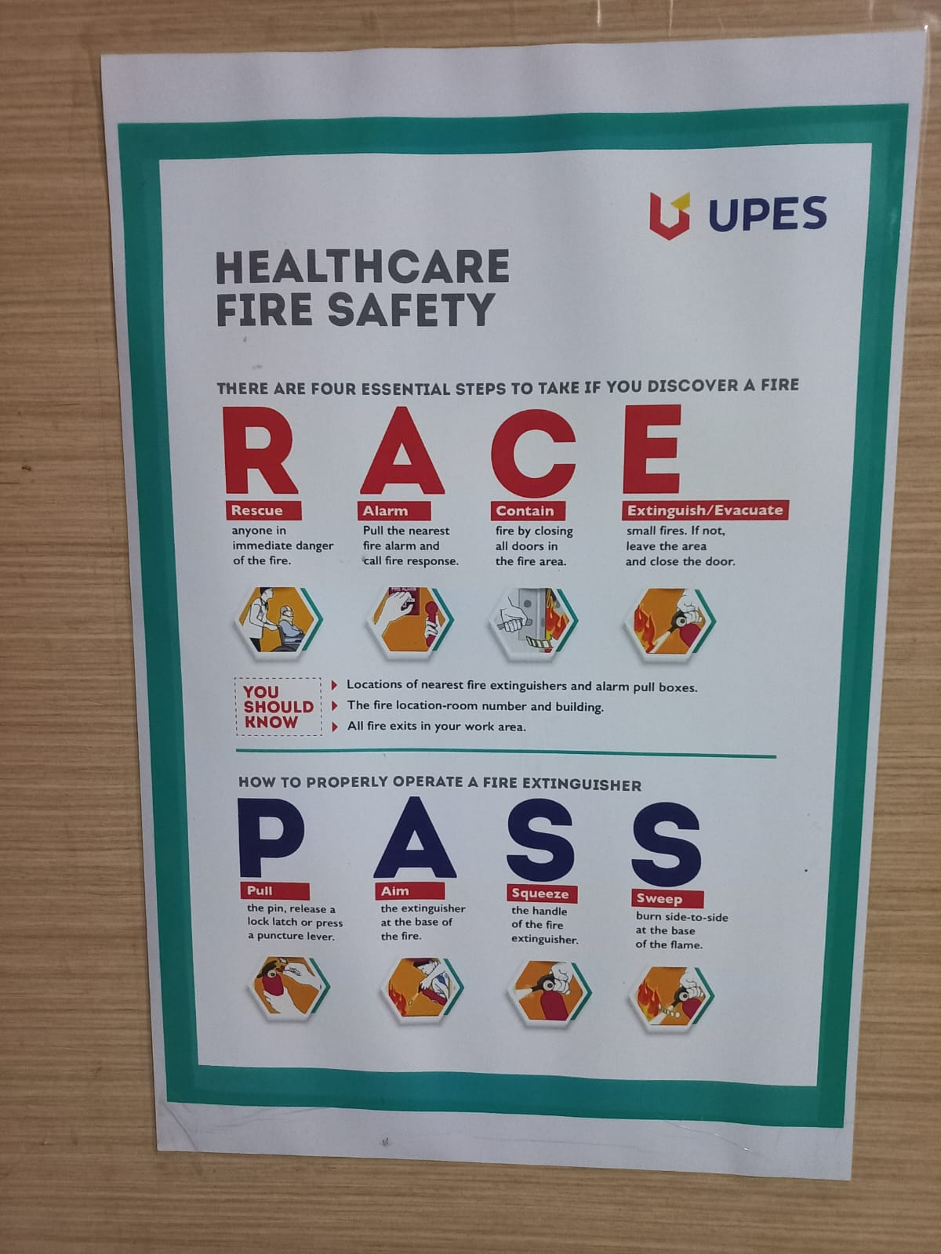
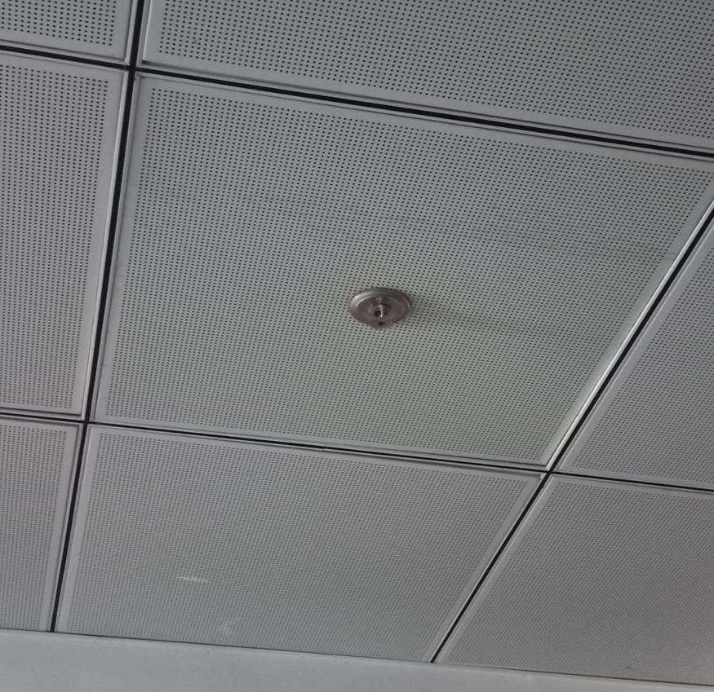
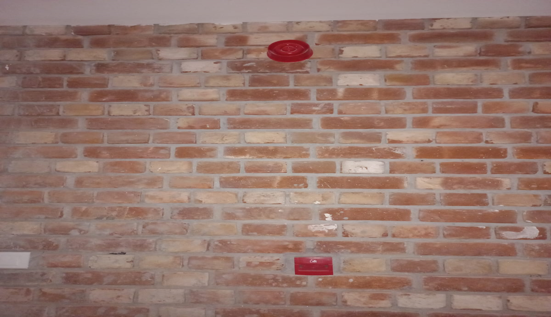
FIRE SPRINKLERS:
FIRE ALARMS:
SAFETY POSTER

Slide 7
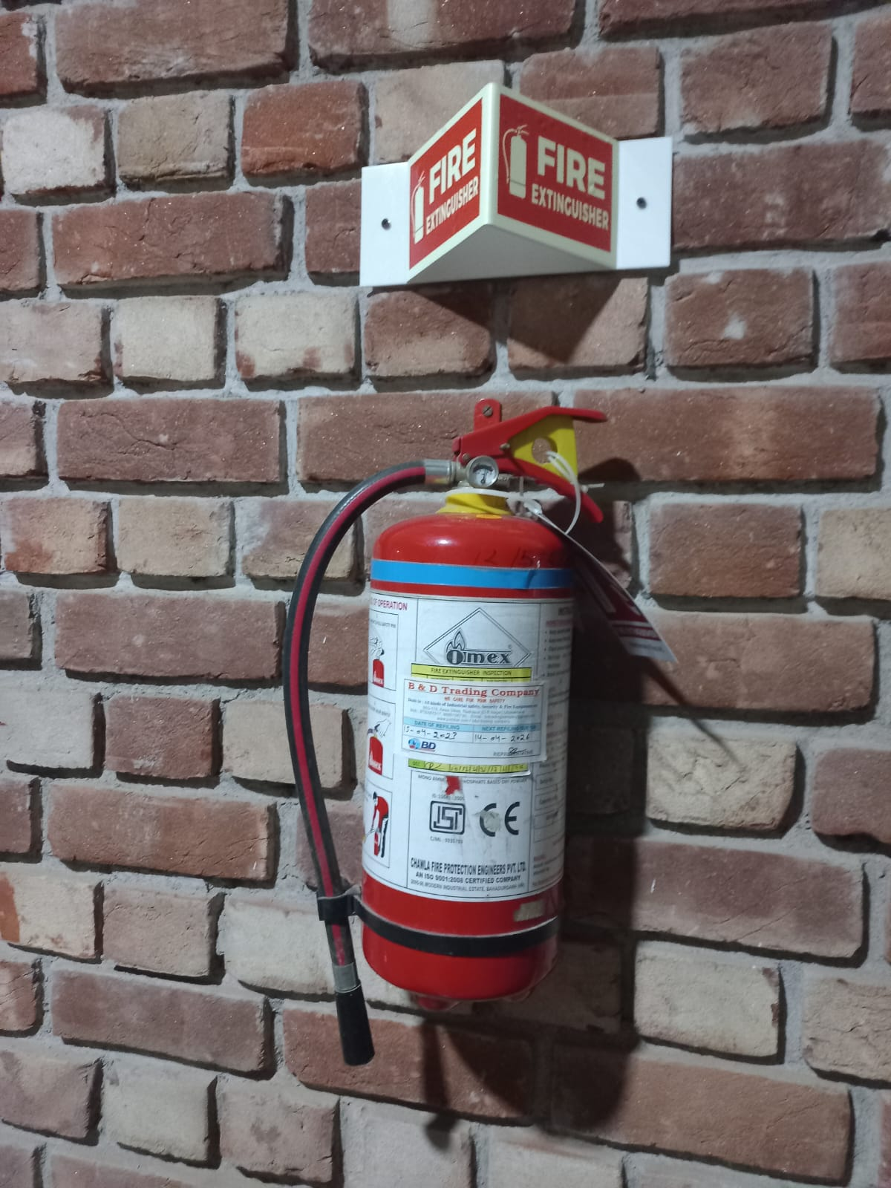
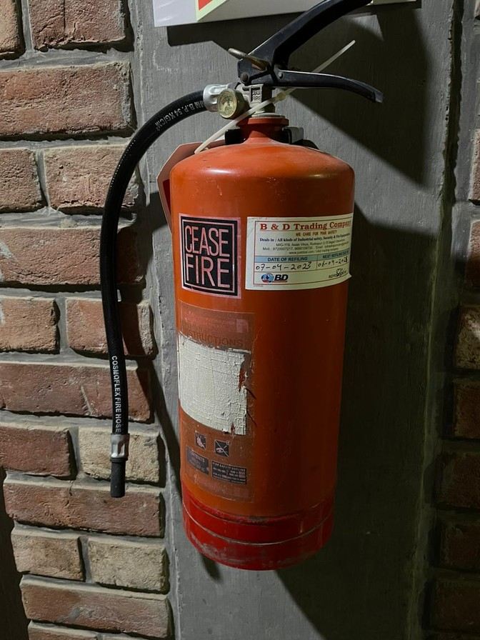
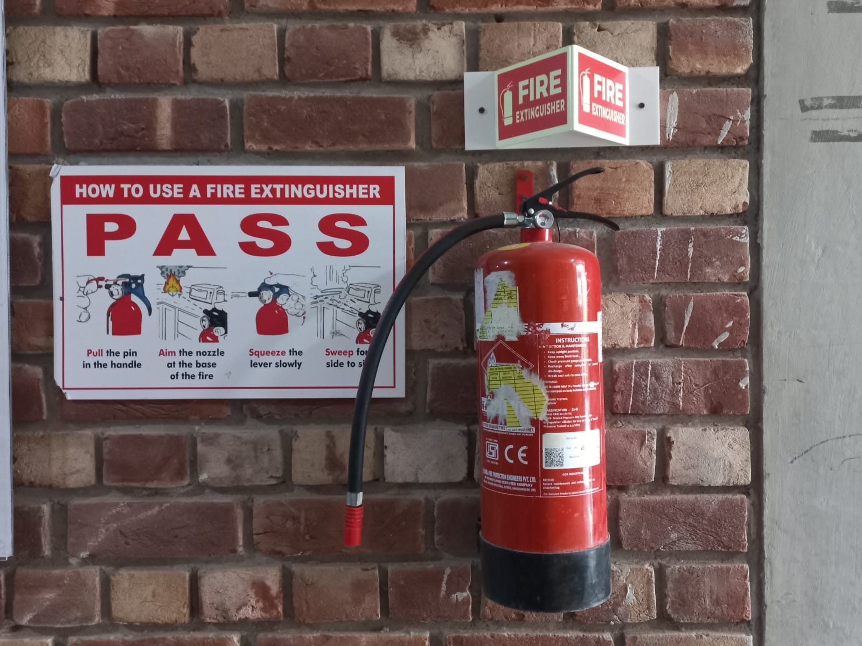
FIRE EXTINGUISHERS
AND
FIRE HYDRANTS

Slide 8
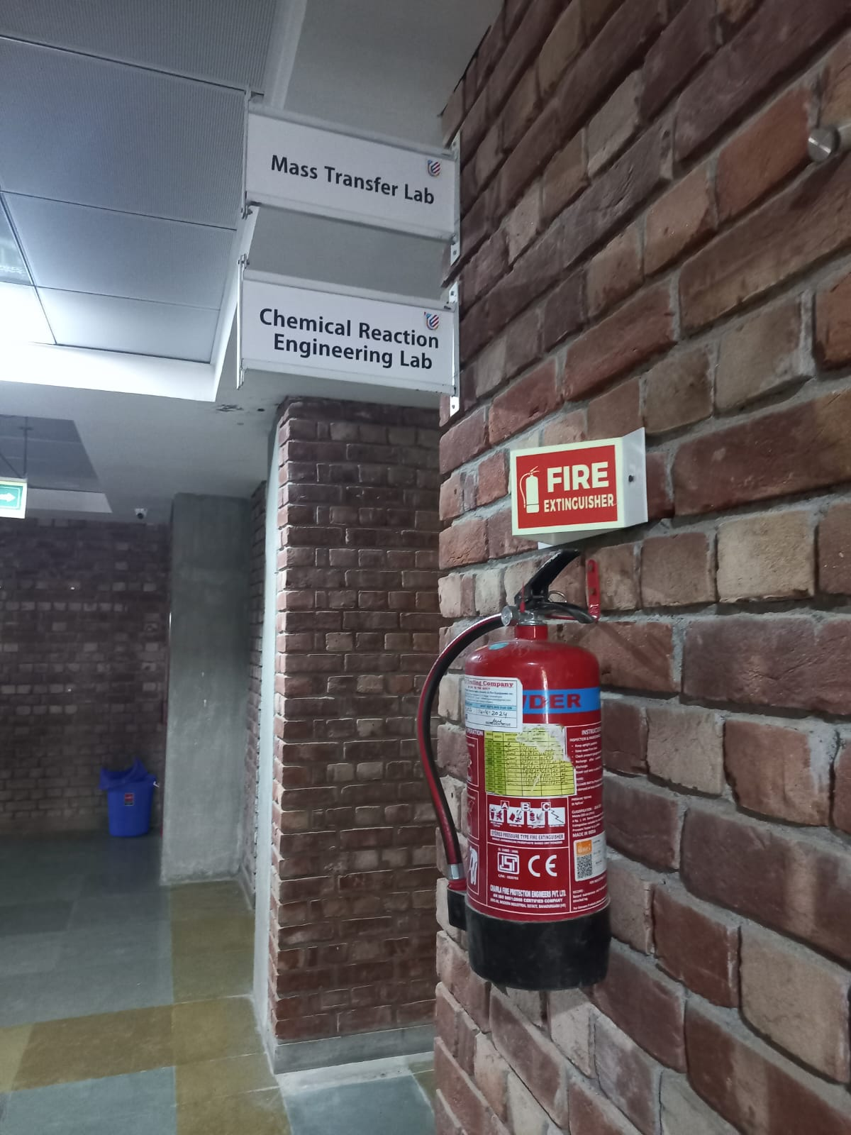
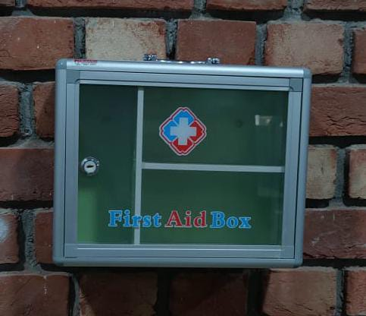
WRONG FIRE EXTINGUISHER
EMPTY FIRST AID

Slide 9
THE CAMPUS HAS FIRE HYDRANTS AND HOSE REELS
THERE ALSO EXISTS A TEAM OF TRAINED
PROFESSIONALS TO HANDLE A CRISIS.

Slide 10
THANK YOU!

